Slide 1
LAY’S: DO US A FLAVOR CAMPAIGN
SERVAS ANALYSIS

Slide 2
Do Us a Flavor Campaign
Lay's Do Us a Flavor campaign
Do Us a Flavor Case
Frito-Lay’s Do Us a Flavor Contest

Slide 3
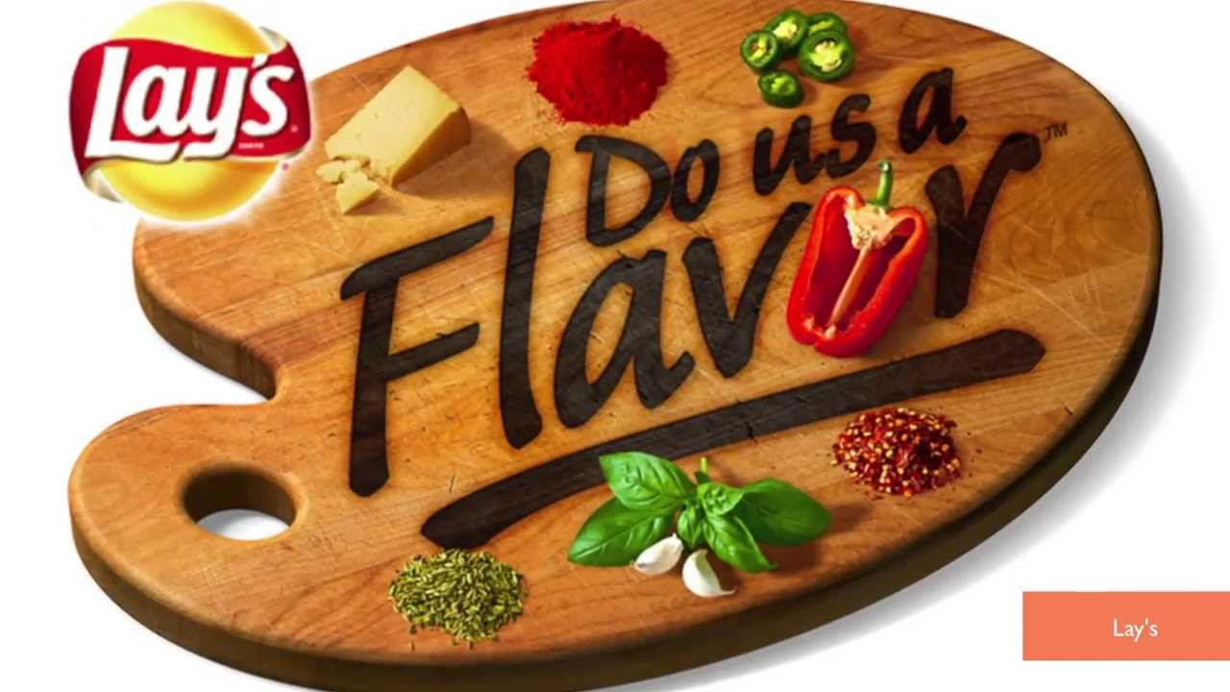
SERVAS Digital Analysis
Sustainable Goals
Allow more consumer involvement in creating chip flavors
Improve social media presence
Increase sales to customers in the United States and other countries
Create a wider variety of chips in the brand

Slide 4
Engagement
Reached Target market through social media influence, creation of a flavor store in New York City
Message allows the customer to choose what flavor they like best, and also input their own ideas
Brand uses customer reaction to certain flavors from other countries/states to attract new customers
https://www.youtube.com/watch?v=VMmCZOZeT_k

Slide 5
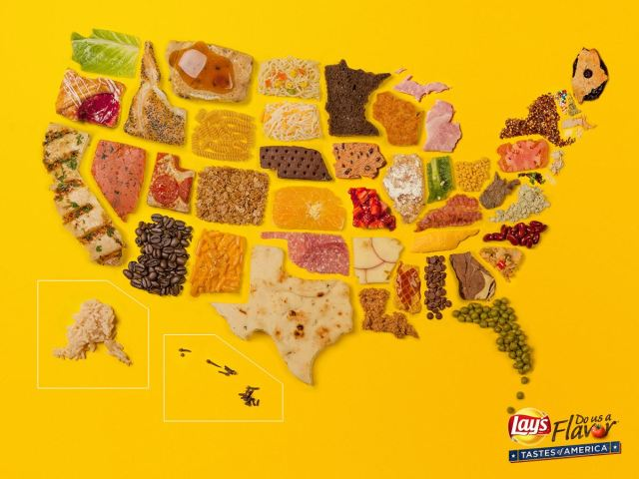
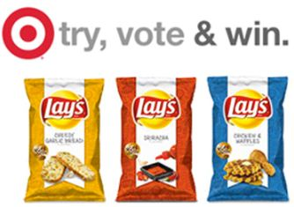
THE ASK

Slide 6
Relationships
Campaign creates interactivity on Lay’s Facebook, and Twitter
Customers can vote online, and submit new chip flavors also
Allows the customer to feel in charge of campaign
Increases the positivity among Lay’s customers

Slide 7
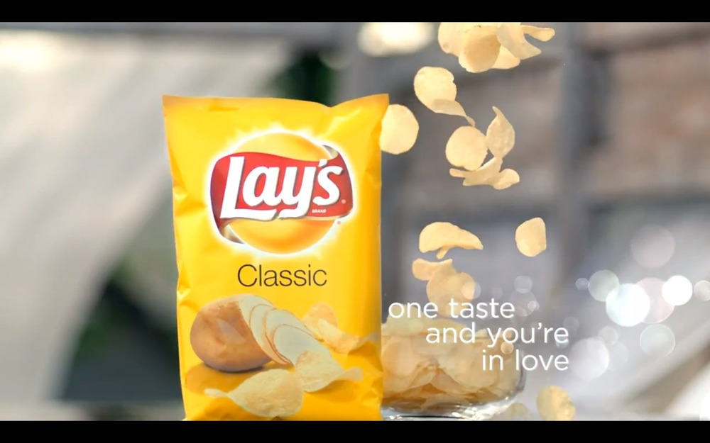
Value
Campaign benefits both organization and individuals with customer involvement and data feedback for organization
Continues the Lay’s slogan of “one taste and youre in love” by creating the flavors customers will love
Importance of customer opinion and input on chip flavors

Slide 8
Action
Action is achieved through constant involvement with customers, aiming to please everyone through the Do Us a Flavor campaign
Social Media interaction greatly increased in the start of campaign and continues to grow
Celebirty involvement helps aid the campaign in being successful through online and tv commercials, reaching out to customers

Slide 9
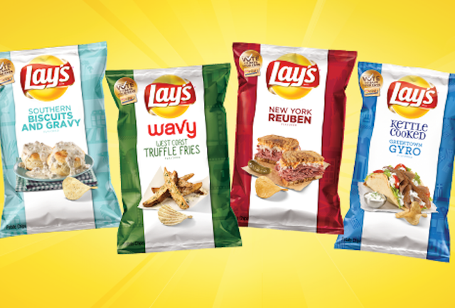
Synergy
Campaign transforms Lays into digital strategy
Create more voting websites other then Facebook
Though consumer involvement online, it allows the organization to have a greater digital presence, therefore increasing sales across the country

Slide 10
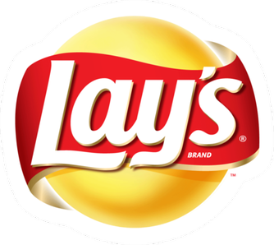
Takeaways
Allow customers to explore your brand
Reach a wide audience
Generate strong brand loyalty
Give people a reason to get invested in your company.
(Submission was an investment)

Slide 11
Sources
http://finance.yahoo.com/blogs/daily-ticker/us-flavor-lay-launches-1-million-chip-flavor-192908678.html
http://www.prnewswire.com/news-releases/lays-do-us-a-flavor-contest-returns-to-the-us-with-1-million-grand-prize-for-best-potato-chip-flavor-idea-300021897.html
https://www.youtube.com/channel/UCw3RyPiunzItoI61fJrdHjQ

